Slide 1
Multi-threaded Space Carving for 3-D Seed Reconstruction
Mitchell Neilsen, Kai Zhao
Computer Science Department
Kansas State University
Manhattan, KS, USA
{neilsen@ksu.edu, kzhao@ksu.edu}

Slide 2
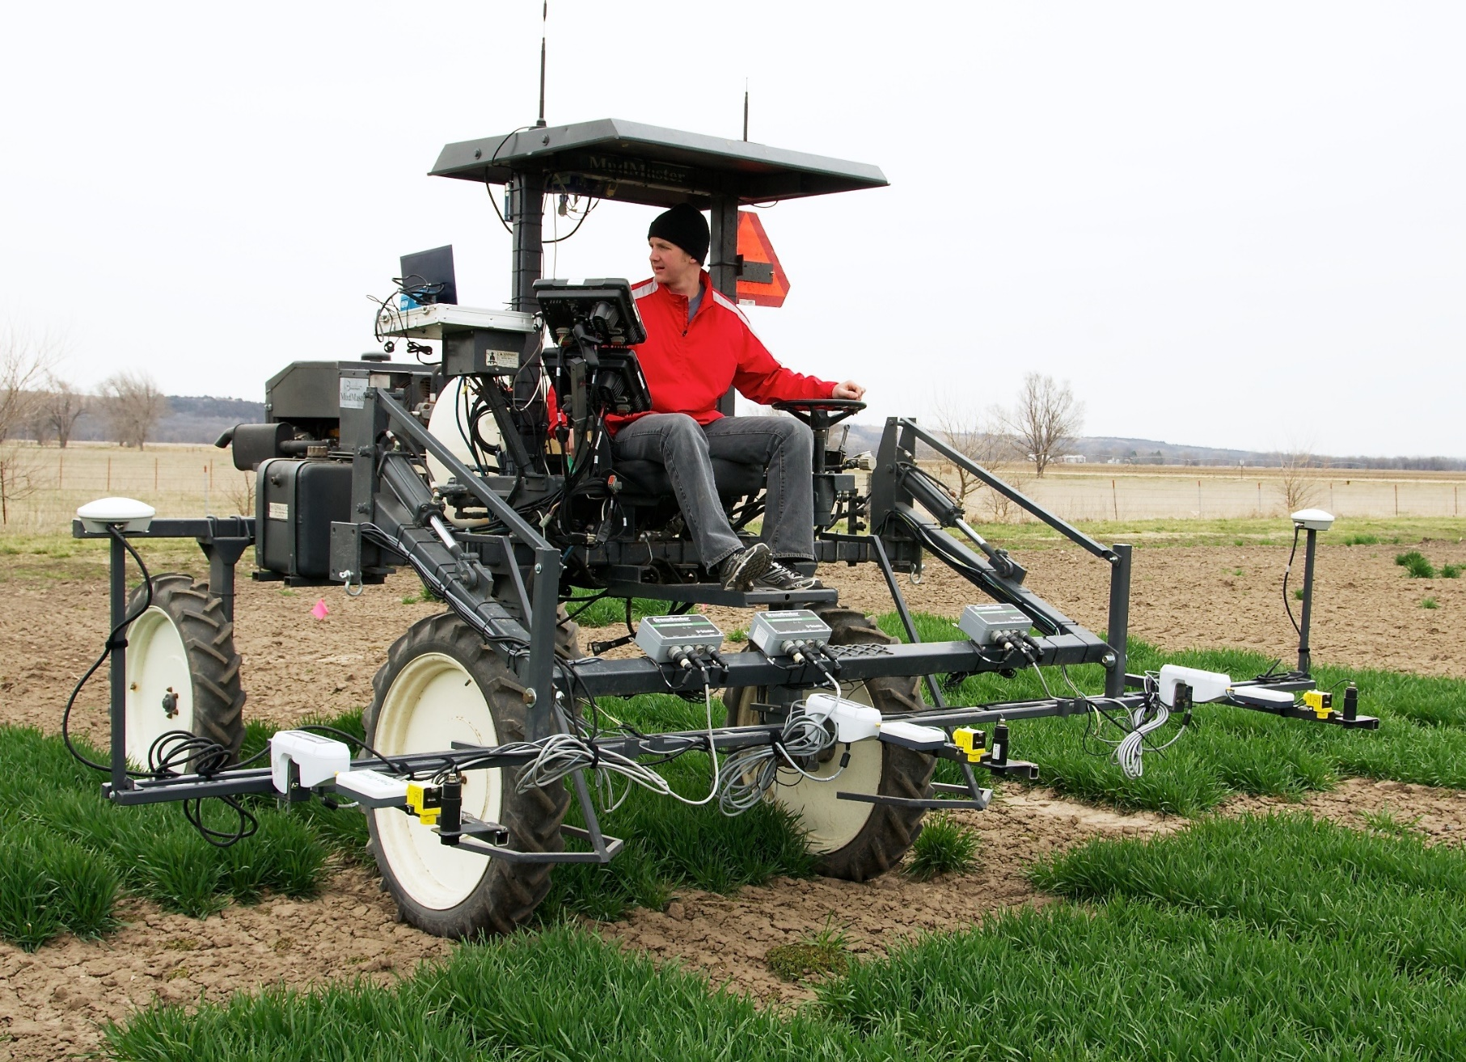
High-Throughput Phenotyping at K-State

Slide 3
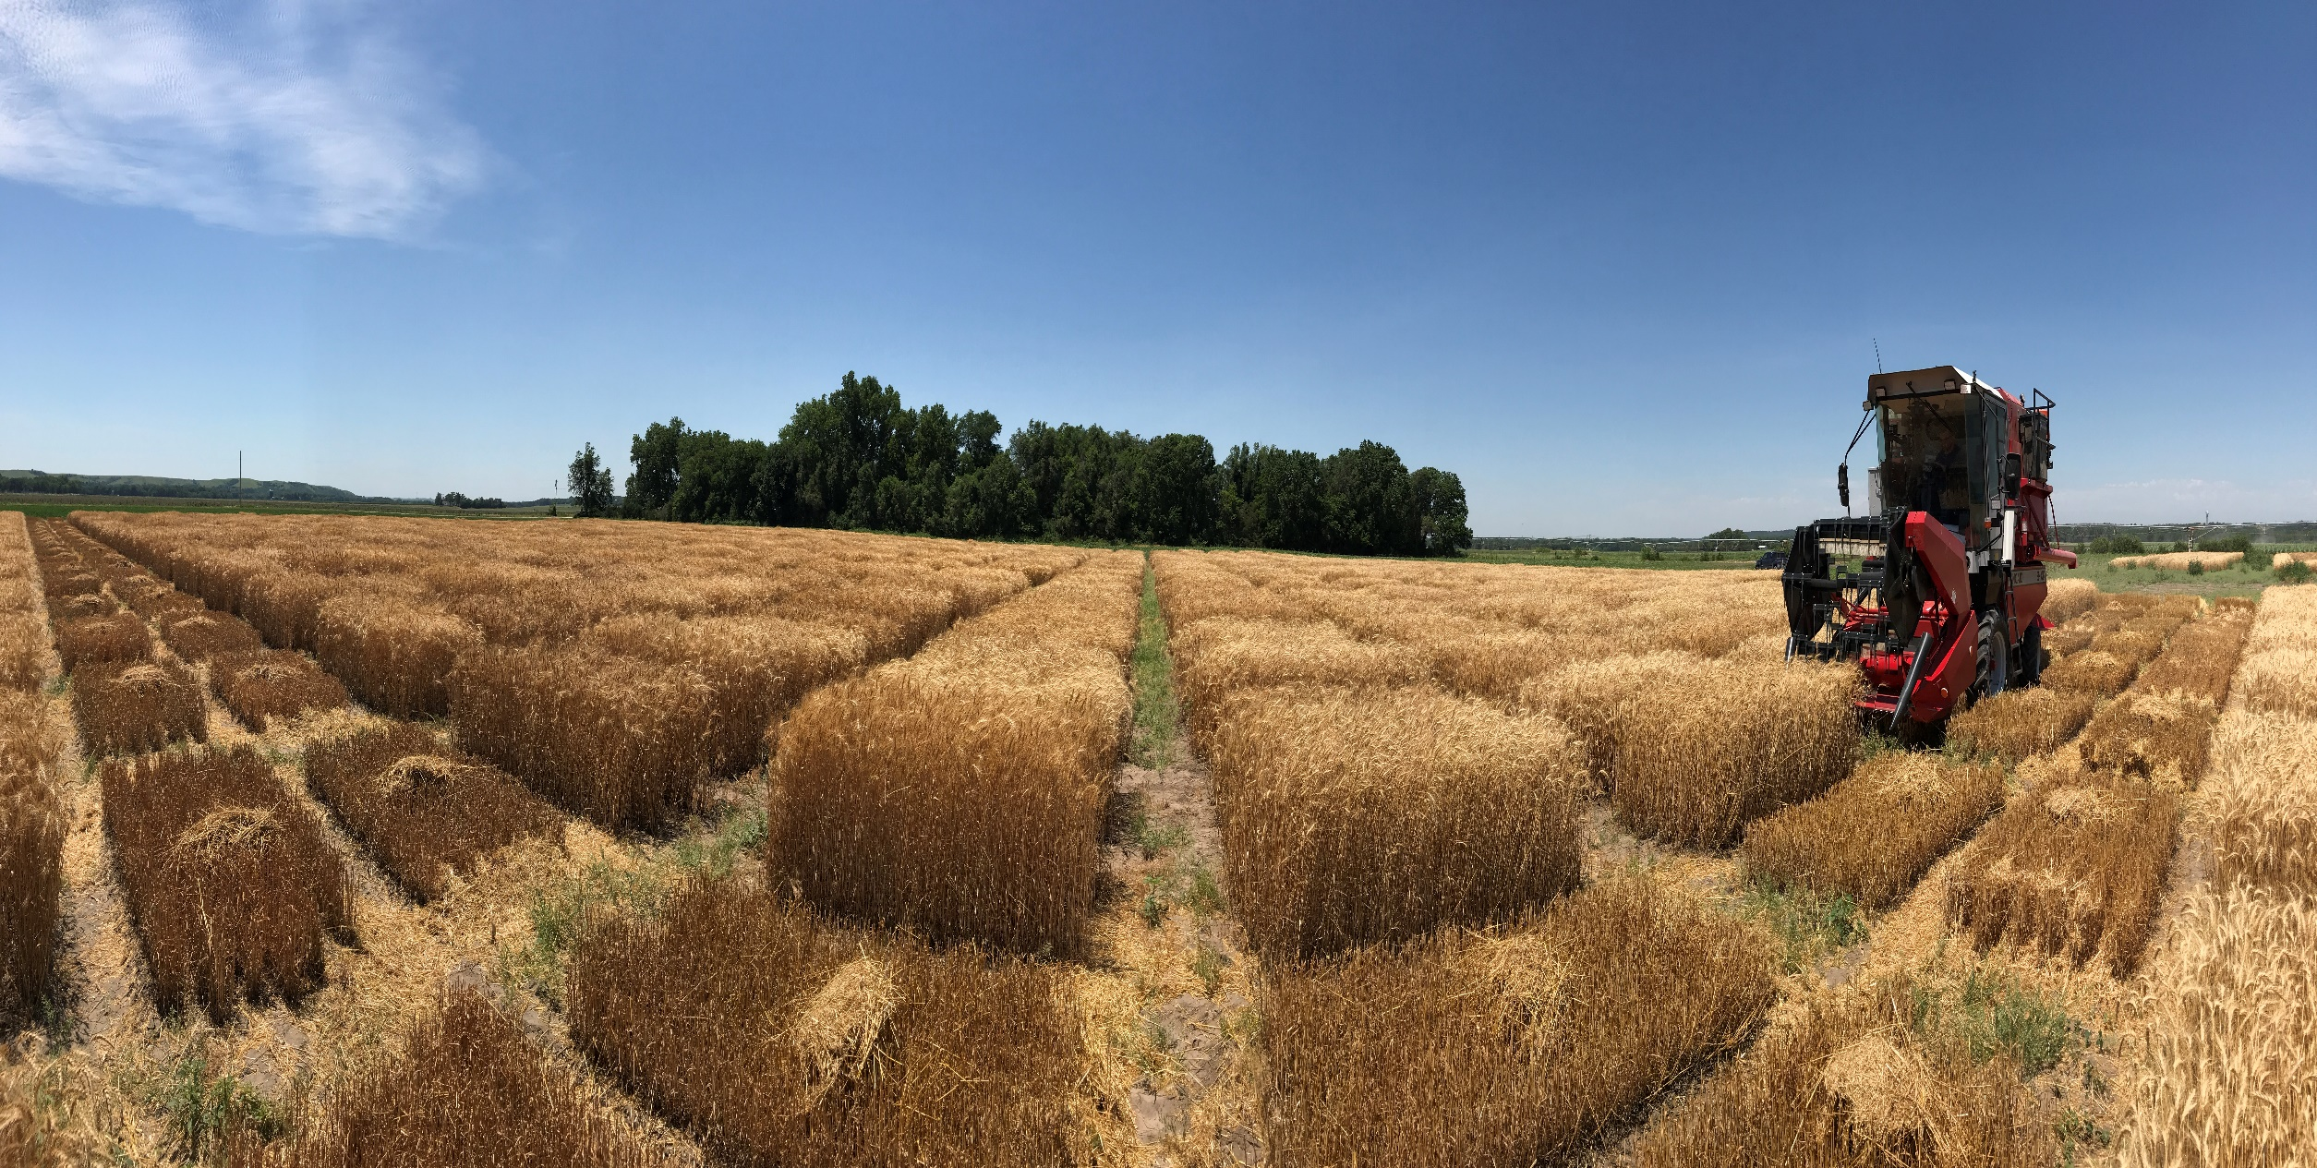
Harvest Time

Slide 4
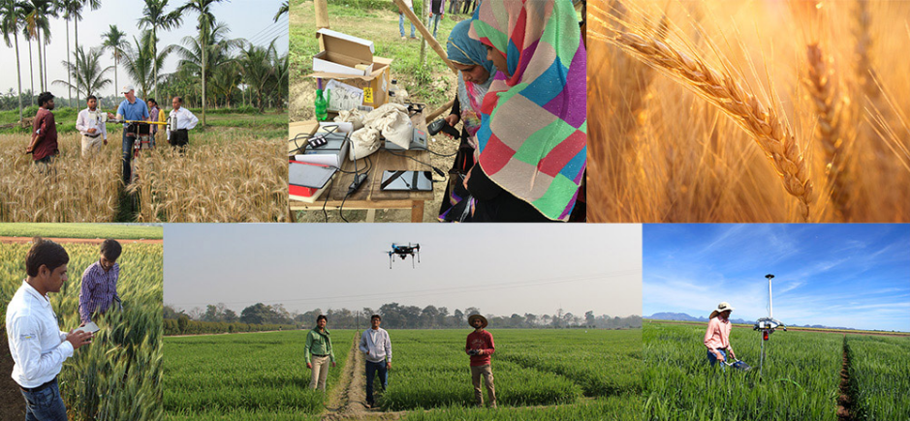
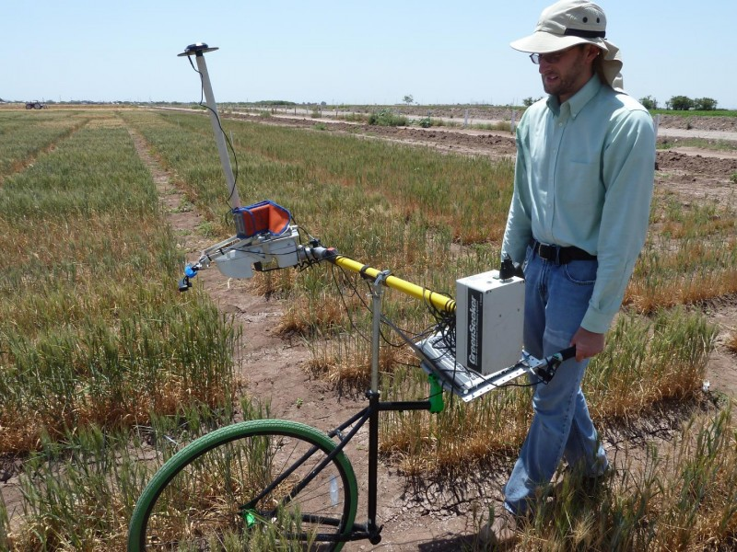
Lower Cost, Lower Throughput Phenotyping

Slide 5
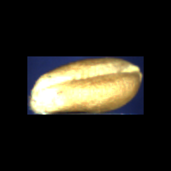
Overview – Seed Volume + Density
Challenges in computing seed volume
Seeds have a variety of shapes; e.g., wheat seeds are generally oblong with a blunt tip and crease
Seeds have a variety of colors which may vary within a seed
Volume measurement w/ liquid displacement may damage the seeds
Computer Vision and Space Carving to Compute Volume
Need sufficient images from different angles
Use Multiple Threads to Speed Up Computation
Allow concurrent threads to carve different masks

Slide 6
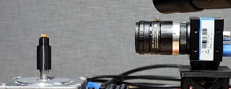
Hardware Configuration
Camera: Imaging Source DFK 37BUX287 or 290 industrial camera (720x540 or 1920x1080) with Fujinon Lens
Stepper Motor: NEMA23 controlled using Arduino UNO R3 and Synthetos gSheild Stepper Controller with microstepping for accurate (e.g., 10-degree) rotations between images
Seed Holder: 3-D printed seed holder

Slide 7
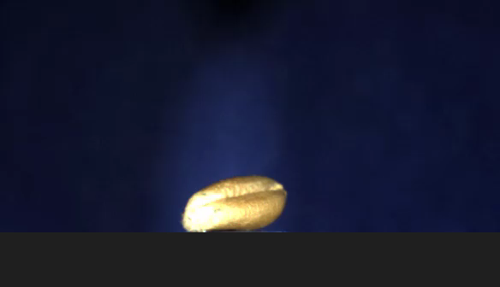
Capture 36 images in just over 1 sec.

Slide 8
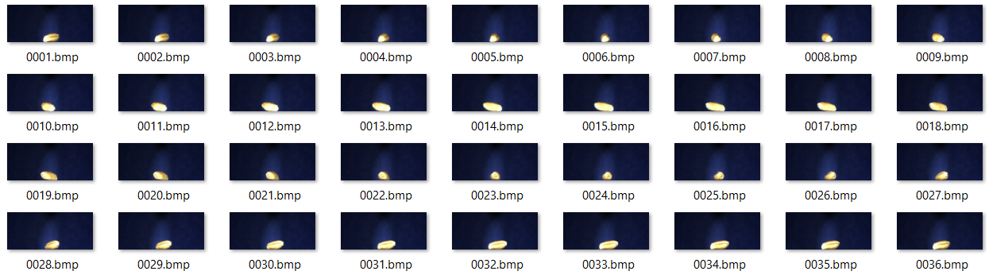
Captured Images

Slide 9
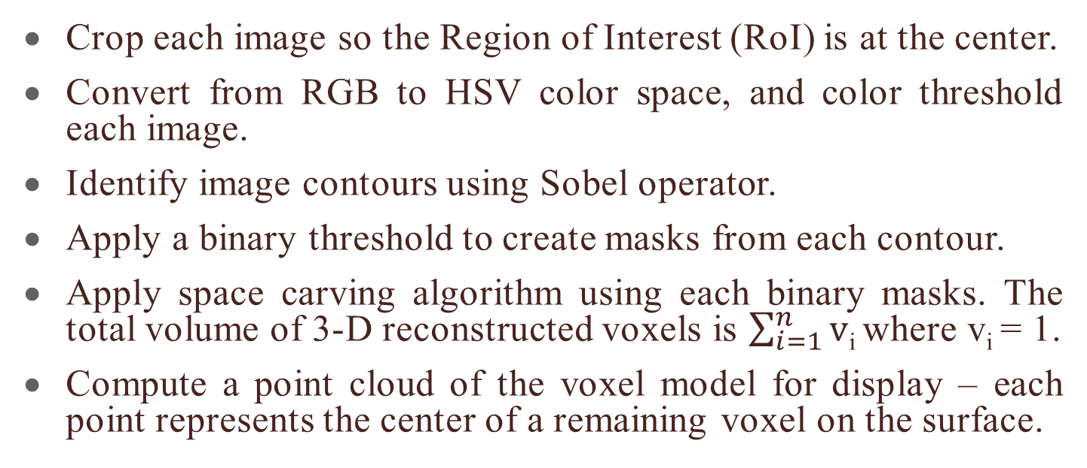
Basic Algorithm
Crop each image so the Region of Interest (RoI) is at the center.
Convert from RGB to HSV color space, and color threshold each image.
Identify image contours using Sobel operator.
Apply a binary threshold to create masks from each contour.
Apply space carving algorithm using each binary masks. The total volume of 3-D reconstructed voxels is $\sum_{i=1}^{n}{v}$_{i} where v_{i} = 1.
Compute a point cloud of the voxel model for display – each point represents the center of a remaining voxel on the surface.

Slide 10
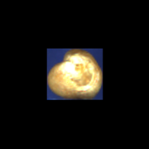
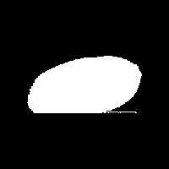

Identify Region of Interest (RoI) and Apply Binary Mask
RoI = blue box
Computed Mask

Slide 11
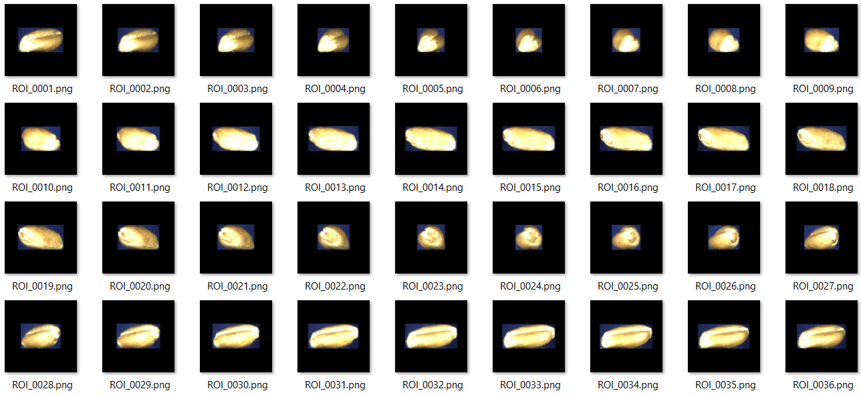
Identify Region of Interest

Slide 12
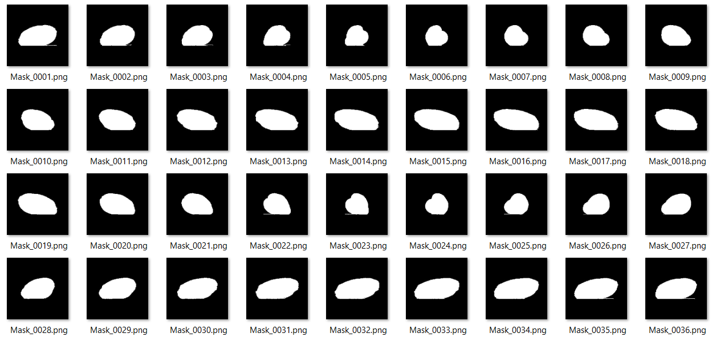
Create Binary Masks

Slide 13
Base Space Carving Algorithm
Initialize the voxels V to be a volume containing the true object. We just use a simple 3-D 100 x 100 x 100 voxel grid with all voxels initially set to 1.
For each binary mask:
For each voxel v ϵ V:
a. Project v onto the mask to 2-D mask point _{v}
b. If _{v} is non-photo-consistent and v == 1, set v=0

Slide 14
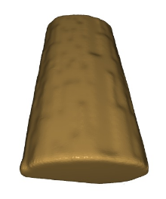
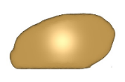

Back Project Voxel Grid onto Each Mask Image and Carve
Remaining volume = 102.354 mm³
Voxel grid is 100 x 100 x 100 voxels or 10 mm x 10 mm x 10 mm = 1,000 mm³

Slide 15
Multi-threaded Space Carving
Allow each thread to carve using a subset of the mask images.
A total of 36 masks are used, so 1 to 36 threads are considered.
Case 1: Running on a Dell G16 7620 Windows 11 Pro with an Intel® Core ™ i7-12700H CPU @ 2.3 GHz, 14 Core(s), and 20 Logical Processors, and 16 GB RAM
Case 2: On a more modest Dell 7480 Windows 10 Pro with an Intel® Core ™ i7-6600U CPU @ 2.6 GHz, 2 Core(s), and 4 Logical Processor(s), and 8 GB RAM
Compute max, min, mean for 100 trials each

Slide 16
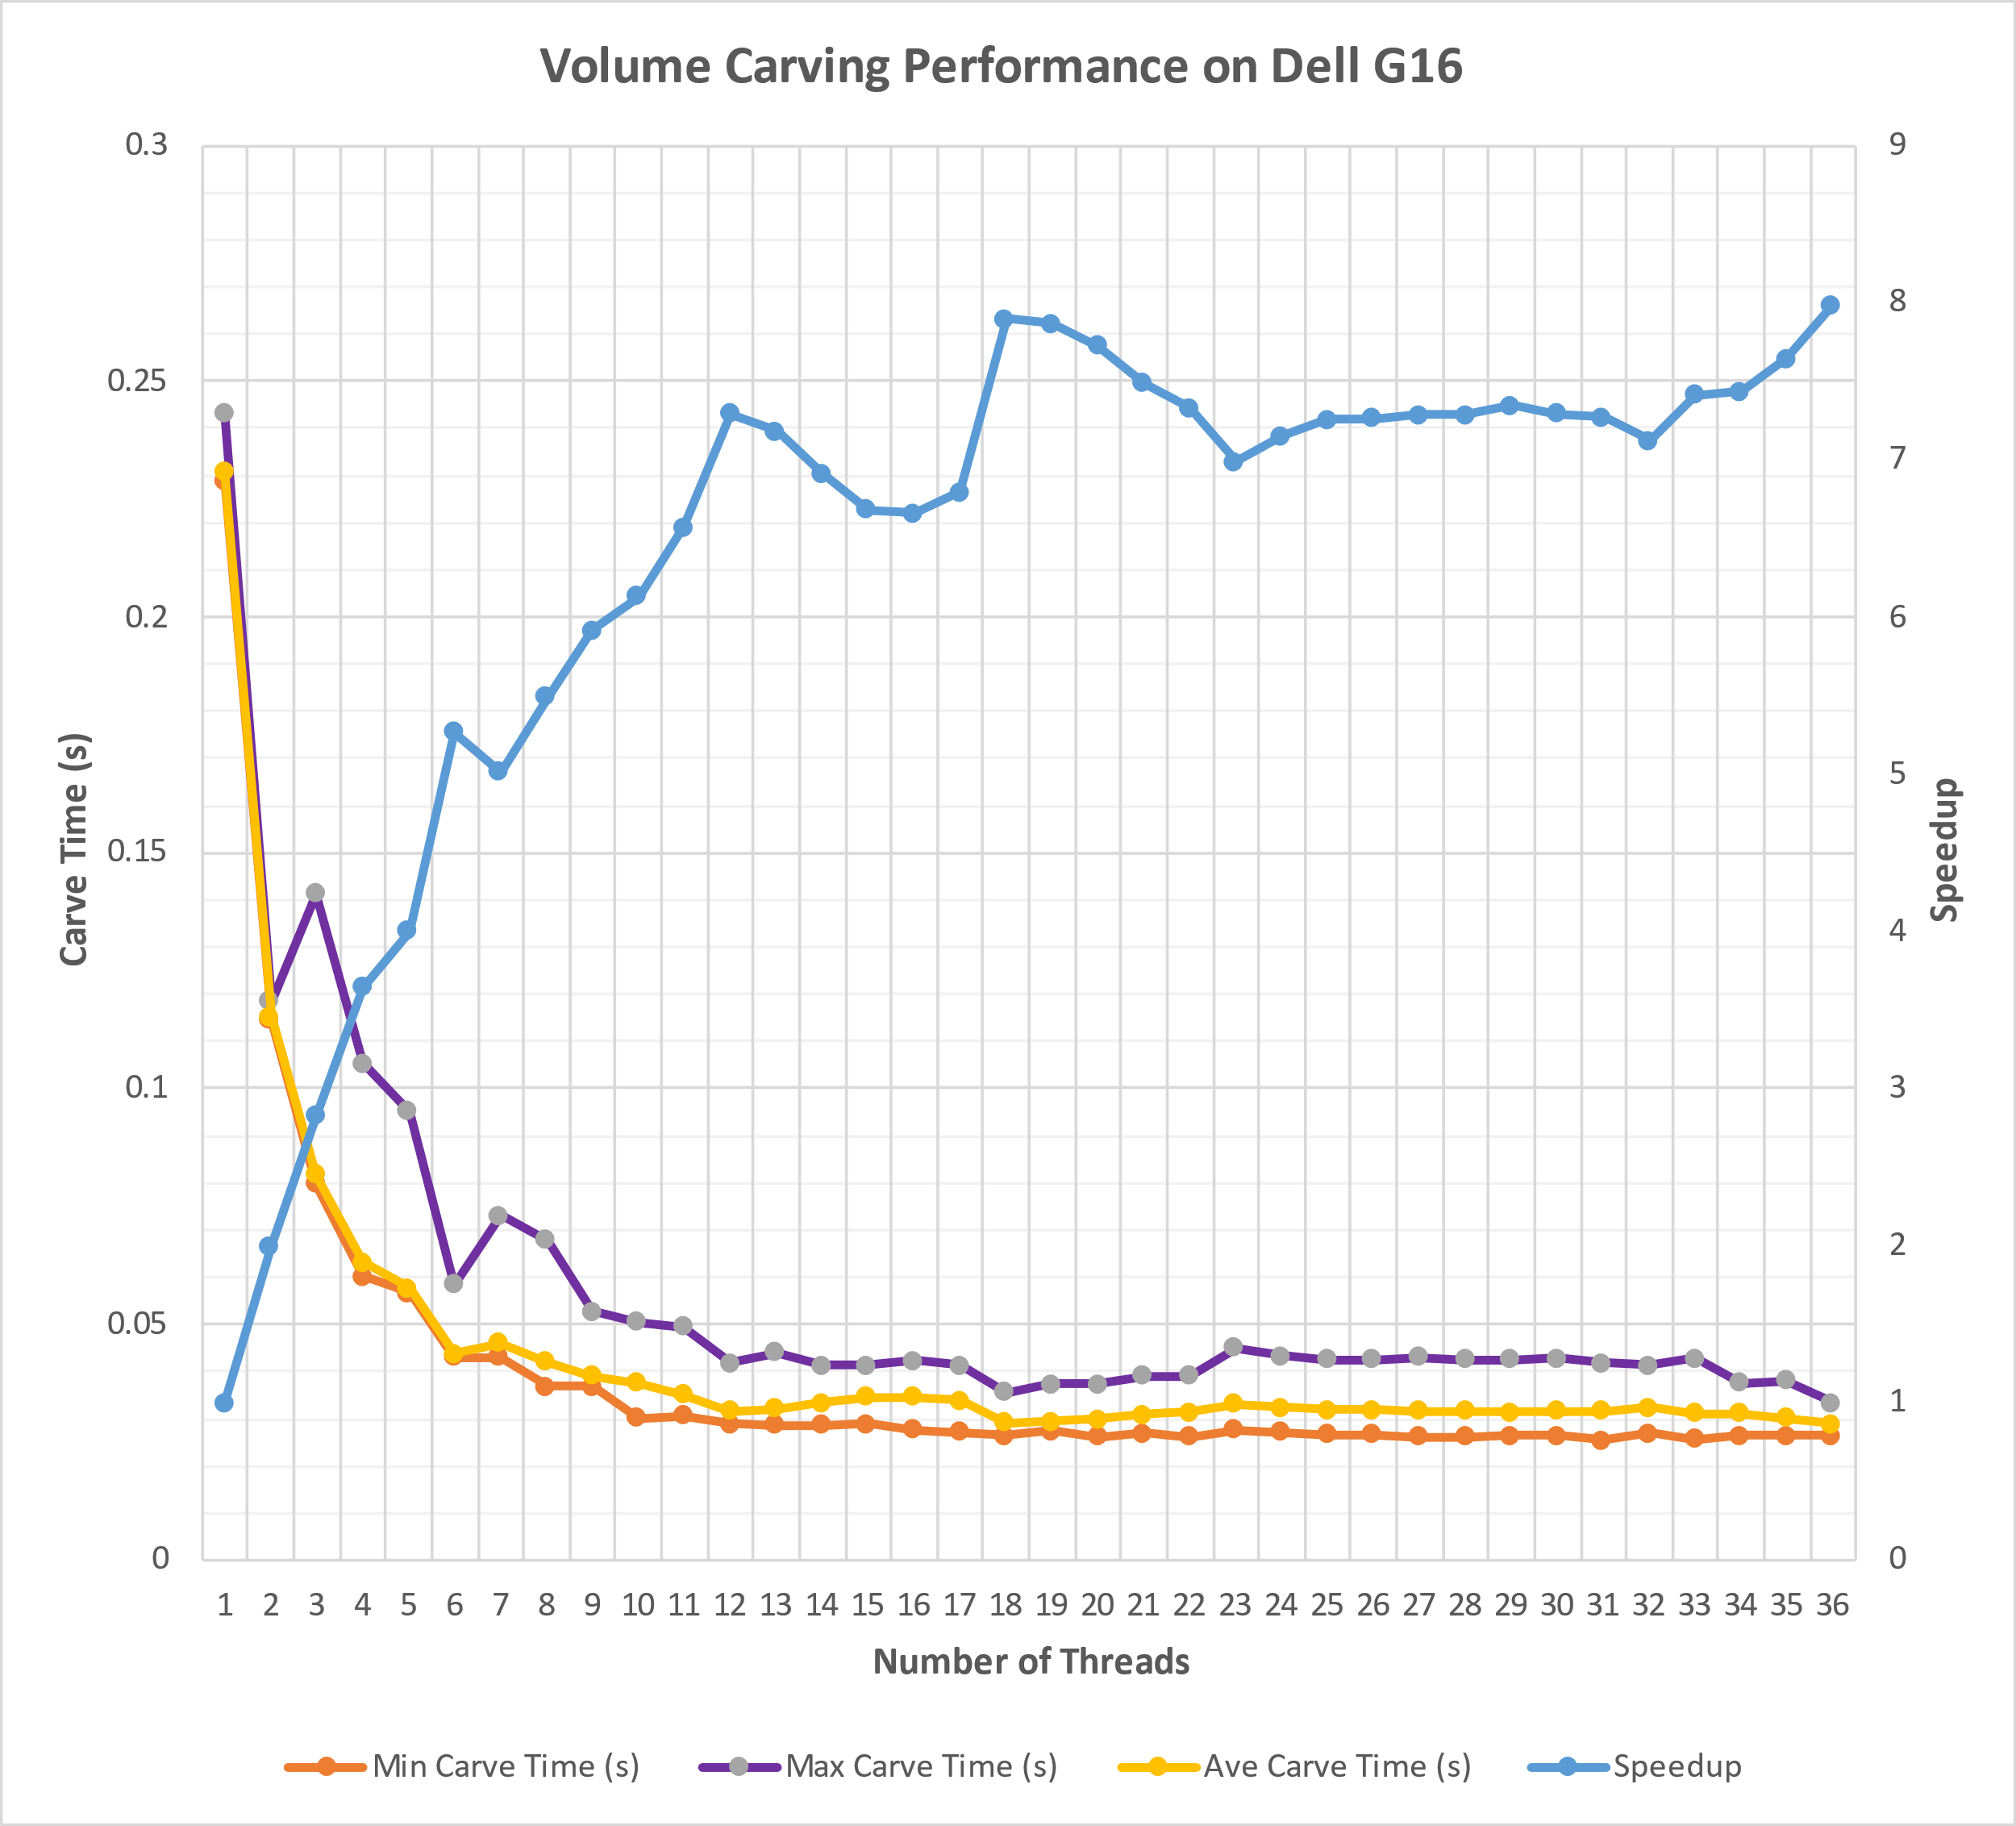
Multi-threaded Performance Comparison
8x speedup
0.23 sec.
5x speedup
36 tasks to complete
0.0292 sec.
0.02874 sec.

Slide 17
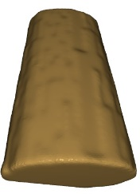
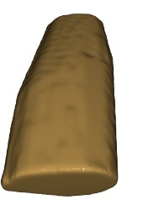
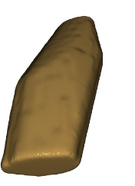
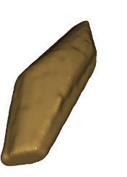
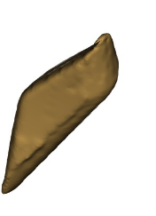
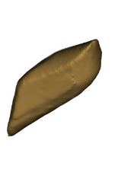
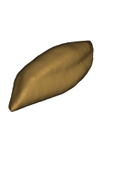
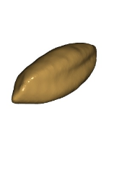
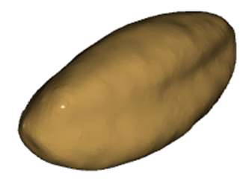
Sequential Carve Steps Note: majority of voxels are removed after the first step
(0) (1) (2) (3) (4)
(5) (6) (7+8)
(4) (5) (6) (7 and 8)
Figure 5. Space carving with masks 0, 1, 2, 3, 4, 5, 6, and 7/8.

Slide 18
Check Target Space Carving Algorithm
Initialize the voxels V to be a volume containing the true object. We just use a simple 3-D 100 x 100 x 100 voxel grid with all voxels initially set to 1.
For each binary mask (in parallel):
For each voxel v ϵ V: if v == 1: // still hasn’t been carved
a. Project v onto the mask to 2-D mask point _{v}
b. If _{v} is non-photo-consistent, set v=0

Slide 19
PreProcess + Check Target Algorithm
1. Initialize the voxels V.
2. For one mask: // preprocess
For each voxel v ϵ V: // no need to check if v == 1
a. Project v onto the mask to 2-D mask point _{v}
b. If _{v} is non-photo-consistent, set v=0
3. For each remaining binary mask (in parallel):
For each voxel v ϵ V: if v ==1:
a. Project v onto the mask to 2-D mask point _{v}
b. If _{v} is non-photo-consistent, set v=0

Slide 20
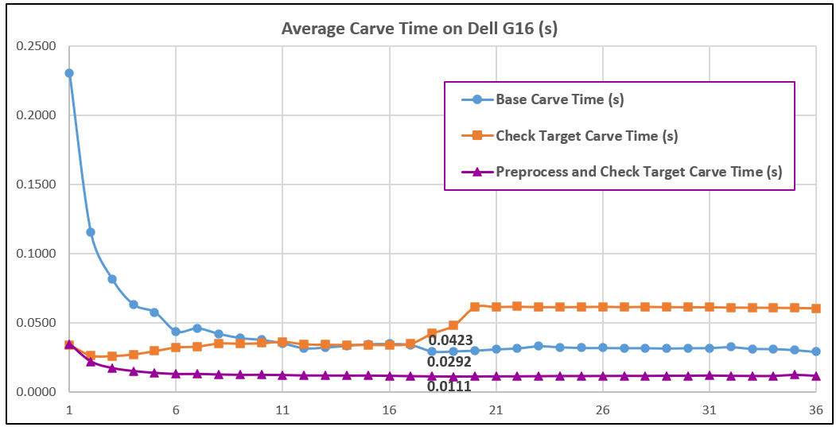
Compare the Three Space Carving Algorithms
0.23 sec.
.
0.03 sec.
.
.

Slide 21
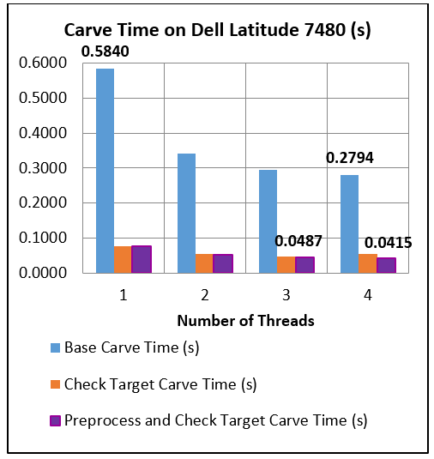
Performance on Dell Latitude 7480

Slide 22
Conclusions
Multi-threaded space carving with modest adjustments can be used to effectively speed up carving process:
Even on modest hardware: over 0.584 sec to 0.0415 sec (14x faster)
On Dell G16: 0.23 sec to 0.0111 sec (21x faster)
Algorithms and experimental data are readily available on GitHub.
Future plans include testing with more grid elements, using GPUs, and speeding up the other parts of the system.
For phenoApps: https://www.phenoapps.org/

Slide 23
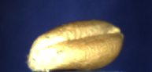
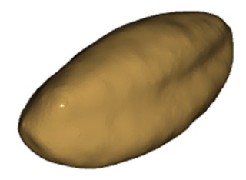

Questions?
Typical wheat seed with crease → 3-d model

